Slide 1


Potential Drug-Drug Interactions in the Pediatric Intensive Care Unit An Analysis using Safe ICU and DD Inter Drug Database A Project Presentation
Presented by
Aaron Augustine Fernandes
B.Tech IT
Manipal Institute Of Technology, Bengaluru
Under the Guidance of
Prof. Dr. Tavpritesh Sethi
IIIT Delhi

Slide 2
Background
Drug–Drug Interactions (DDIs) occur when one medication alters the effect of another, potentially reducing efficacy or increasing toxicity.
Pediatric ICU patients are particularly vulnerable due to polypharmacy, complex treatment regimens, and rapidly changing clinical conditions.
Undetected DDIs can contribute to prolonged hospitalization, adverse drug events, and increased healthcare burden.
Motivation -
Manual identification of DDIs from clinical records is time-consuming and prone to oversight.
Leveraging the SafeICU dataset together with the DDInter database enables automated detection and analysis of potential DDIs.
Understanding the prevalence and risk factors of DDIs can support safer prescribing practices and improve patient outcomes.

Slide 3
Problem Statement And Objective
Problem Statement
Patients admitted to the Pediatric ICU are often prescribed multiple medications at the same time.
Some of these medicines can interact with each other and lead to unwanted side effects or reduced treatment effectiveness.
Identifying these interactions manually from clinical notes is difficult and time-consuming.
There is a need for an automated approach to detect potential drug–drug interactions and support safer medication management.
Objectives
Extract prescribed drugs from the SafeICU clinical notes.
Identify potential drug–drug interactions using the DDInter database.
Classify the detected interactions into Major, Moderate, and Minor categories.
Study how factors such as age, gender, number of drugs, length of stay, and mortality are associated with DDIs.

Slide 4
Datasets Used
Dataset | Purpose
SafeICU – Patient Table | Contains patient demographics such as row_id, subject_id ,gender , ages , expire_flag. 1196 rows
SafeICU – Admission Table | Provides prescription details such as Row_id, Subject_id , adm_date, disch_date , release_description. 1196 rows
SafeICU – Note Events Table | Contains clinical notes Row_id , Subject_id , chart_date , diagnosis , description . 1687 rows
DDInter Database | Used to identify potential drug–drug interactions and classify them as Major, Moderate, or Minor. Contains Drug_A , Drug_B , level. 4,44,766 rows

Slide 5
Methodology Overview
SafeICU Dataset
(Patient, Admission & Note Events)
│
▼
Data Cleaning & Preprocessing
(Remove duplicates, handle missing values)
│
▼
Drug Extraction
(Extract prescribed drugs from clinical notes)
│
▼
Drug Pair Generation
(Create all possible drug combinations)
│
▼
DDInter Database Matching
(Identify potential drug interactions)
│
▼
Severity Classification
(Major • Moderate • Minor)
│
▼
Final Patient-Day Dataset
(Drug list, DDI count, LOS, Age, Gender, Mortality)
│
▼
Statistical Analysis
(DDI prevalence, LOS, Logistic Regression)

Slide 6
Methodology
1. Data Import and Preprocessing
Imported the SafeICU Patient, Admission, and Note Events tables along with the DDInter database into the Kaggle Notebook environment.
Performed data cleaning by removing duplicate records, handling missing values, and standardizing drug names to lowercase for consistent matching.
Verified dataset quality by checking data dimensions, data types, and missing values before further analysis.
2. Drug Extraction
Extracted medication names from free-text clinical notes using a rule-based text processing pipeline.
Removed punctuation, tokenized the text, and matched tokens against a predefined list of valid drug names.
Grouped the extracted medications by subject_id and chart_date to create patient-day medication records.

Slide 7
3. Drug Combination Generation & DDI Detection
Generated all possible two-drug combinations for each patient-day using Python's itertools.combinations().
Compared each generated drug pair with the DDInter lookup dictionary to identify clinically recognized potential DDIs.
Retained only matched drug pairs for further severity classification and analysis.
4. Severity Classification & Admission Integration
Classified detected interactions into Major, Moderate, and Minor severity categories.
Recorded both the interacting drug pairs and the corresponding number of interactions for each patient-day.
Linked each patient-day record to the correct hospital admission using admission and discharge dates, and calculated the Length of Stay (LOS).

Slide 8
5. Final Analytical Dataset
Merged the patient-day DDI records with demographic information from the Patient table.
Included variables such as age, gender, mortality status, medications, DDI severity, number of drugs, and LOS.
Constructed a comprehensive patient-day dataset for downstream statistical analysis.
6. Exploratory Data Analysis
Summarized patient demographics and medication utilization across the study population.
Evaluated DDI prevalence, severity distribution, and the most frequently occurring interacting drug pairs.
Compared patients with and without DDIs and examined key clinical characteristics before statistical modeling.

Slide 9
Final Analytical Dataset
Final Dataset
After processing and DDI detection, a patient-day level dataset was created for analysis.
The final dataset included:
- Subject ID
- Patient demographics (Age & Gender)
- Number of prescribed drugs
- Drug list for each patient-day
- Major, Moderate, and Minor DDIs
- Total DDI count
- Length of Stay (LOS)
- Mortality status
Statistical Analysis Performed
- Patient characteristics
- DDI prevalence
- Most frequent drug interaction pairs
- Multivariate logistic regression

Slide 10
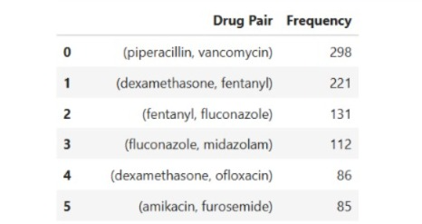
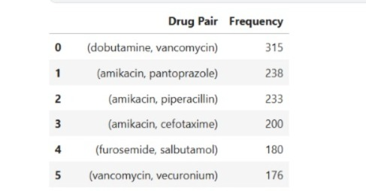
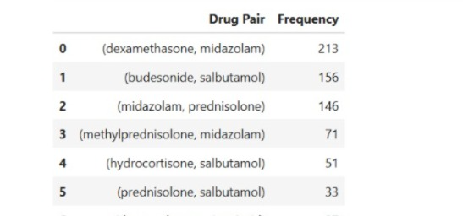
Most Frequent Drug Interactions
Top 5 Most Frequent Major , Moderate And Minor Drug Pairs
Major
Moderate
Minor

Slide 11
Exploratory Results
Dataset Overview
Final analytical dataset consisted of 6,941 patient-day records from 709 unique patients.
435 patients had at least one potential Drug–Drug Interaction (DDI), while 274 patients had no identified DDIs.
The median age of the study population was 5.36 years, with ages ranging from 0.17 to 18.85 years.
The study included 427 Male patients and 282 female patients, and 4275 Male prescriptions and 2666 Female prescriptions ,providing a representative pediatric ICU population.
Key Observations
A considerable proportion of patients experienced at least one potential DDI.
Most detected interactions belonged to the Moderate severity category.
- 6,941 Patient-Day Records
- 1679 DDI’s Major Severity
- 6807 DDI’s
Moderate Severity
- 921 DDI’s Minor Severity
- 5.36 yrs
Median age
- 0.17 yrs
Min age
- 18.85 yrs
Max age

Slide 12
Multivariate Logistic Regression – Model Development
Final Patient-Day Dataset
│
▼
Feature Selection
(Age, Gender,
No. of Drugs,
Mortality)
│
▼
Create DDI Target
(1 = DDI
0 = No DDI)
│
▼
Train Logistic
Regression Model
│
▼
Odds Ratio
95% CI
P-value
Used the final patient-day dataset, where each row represented a unique patient-day observation.
Selected age, gender, number of prescribed drugs, and mortality as predictor variables, with DDI occurrence (0 = No DDI, 1 = DDI) as the outcome variable.
Removed records with missing predictor values and encoded gender as a binary categorical variable (Male : 0, Female : 1) before model training.
Fitted a multivariate logistic regression model.
Reported Adjusted Odds Ratios (ORs), 95% Confidence Intervals (CIs), and p-values to evaluate the independent association of each predictor with DDI occurrence.

Slide 13
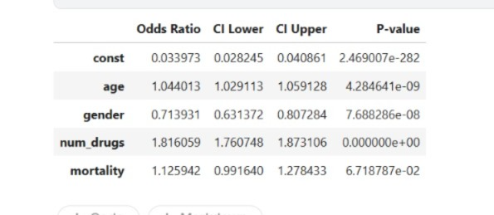
Multivariate Logistic Regression – Results
Key Findings
Age
Age was significantly associated with the occurrence of potential DDIs (OR = 1.044, 95% CI: 1.029–1.059, p < 0.001).
Each one-year increase in age increased the odds of experiencing a DDI by approximately 4.4%.
The 95% confidence interval excluded 1, indicating a consistent positive association, and the p-value (< 0.001) confirmed that this association was highly statistically significant.
Inference: Older pediatric patients had a slightly higher likelihood of experiencing potential DDIs.
Gender
Gender was significantly associated with DDI occurrence (OR = 0.714, 95% CI: 0.631–0.807, p < 0.001).
The category coded as 1 had approximately 28.6% lower odds of experiencing a DDI compared with the reference category.
The confidence interval did not include 1, and the very small p-value (< 0.001) provided strong evidence that the association was statistically significant.
Inference: Gender remained an independent predictor of DDI occurrence in the multivariate model, indicating that differences in DDI risk existed between the two gender groups after controlling for the other covariates.

Slide 14
Multivariate Logistic Regression – Results
Number of Prescribed Drugs (Polypharmacy)
The number of prescribed drugs was the strongest predictor of potential DDIs (OR = 1.816, 95% CI: 1.761–1.873, p < 0.001).
Each additional prescribed medication increased the odds of experiencing a potential DDI by approximately 81.6%.
The narrow confidence interval, which remained entirely above 1, together with the highly significant p-value (< 0.001), indicated a strong and precise association.
Inference: Polypharmacy was the most important independent risk factor for potential DDIs.
Mortality
Mortality showed an estimated OR = 1.126 (95% CI: 0.992–1.278, p = 0.067).
Although the estimated odds suggested a 12.6% higher likelihood of experiencing a DDI, the confidence interval included 1, meaning the true effect could include no association.
The p-value (0.067) was greater than the significance threshold of 0.05, indicating that the observed association was not statistically significant.
Inference: After adjusting for age, gender, and the number of prescribed drugs, mortality was not independently associated with the occurrence of potential DDIs.

Slide 15
Conclusion
Key Takeaways
Developed an automated pipeline to detect potential Drug–Drug Interactions (DDIs) from pediatric ICU clinical notes using the SafeICU dataset and the DDInter database.
Identified and classified potential DDIs into Major, Moderate, and Minor severity categories for each patient-day.
Multivariate logistic regression showed that age, gender, and especially the number of prescribed drugs (polypharmacy) were significantly associated with DDI occurrence.
Future Scope
Re-examine the complete data preprocessing pipeline to identify and correct any inconsistencies.
Validate the analytical results by comparing them with the published methodology and making necessary improvements.
Continue improving the project by incorporating feedback received during the project review.

Slide 16
THANK YOU
Presented by Aaron Augustine Fernandes B.Tech Information Technology Manipal Institute of Technology, Bengaluru
Faculty Guide Prof. Tavpritesh Sethi IIIT Delhi
Project Mentor Ms. Mansi Goel

